Slide 1
Loops!
Intro to CS

Slide 2

Aim: What is a loop in computer programming? How can we use the “while” statement to make loops?
Do Now: int x = 10 If (x = 10){ System.out.println(“My name is Jeff”); }
What does the code above do? Write out the output. Change the code so that the print statement is executed 5 times.
Consider: How would you make a computer execute that print statement 100 times?

Slide 3

What exactly is a loop?
Computers are pretty good at following instructions. Loops are a way for us to tell the computer these instructions so that it can execute lines of code many times – as many times as we see fit.
Running the same code multiple times like this is called iteration.
Similar to the if-else statements we have seen in the past, computer loops use conditions in order to figure out how many times it should execute the code.
While loops and For loops are two of the most common ways to do iteration in computer programming. Today, we will be focusing on while loops!

Slide 4

While Loops
You can read while loops almost as if they were in English: while (this thing is true) { do this thing! } // end loop A few notes:
As long as the condition is true, this part of the program will continue to run.
Of course, if the condition never becomes false, the computer will run that piece of code forever! This is called an infinite loop.
You will often see a loop variable in loops, specifically the letter “i” which stands for iterator.
We will look at a example in java next!
While the nail isn’t all the way in, hammer it!

Slide 5
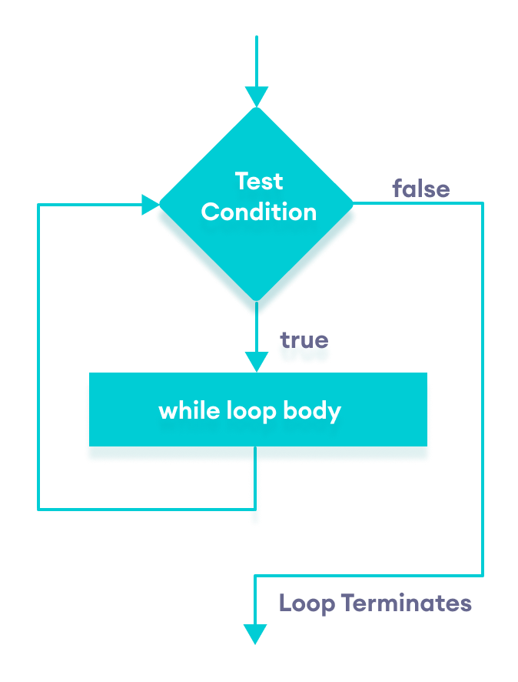

Slide 6
Using increment/decrements to iterate
int iterator = 0; while (iterator < 5) { System.out.println(“Hello world!”); iterator = iterator +1; }
We’ve established that the while loop will run forever until the condition is false. This means that in order to tell the computer how many times we want the code inside the while loop to run, we need to figure out a way to turn the condition from true to false. One way to do this is by using a loop variable/iterator. We create an integer variable named “iterator” and assign it the value of 0. At the end of the loop body, we can add 1 to our iterator. This way, everytime we run through the loop body, iterator goes up by 1. In the above example, the iterator starts at value 0, but after the computer prints out “Hello world!”, the iterator goes up to 1, (and since 1 is still less than 5), it prints it out again, then the iterator goes up to 2, (and since 2 is still less than 5), it prints again, etc.
Once iterator reaches 5, it will no longer be less than 5, and the computer will no longer go through the while loop.

Slide 7
Increment/decrements contd.
int iterator = 5; while (iterator > 0) { System.out.println(“Hello world!”); iterator = iterator - 1; }
This does the same exact thing as the previous, but notice we have the iterator start at 5, then subtract 1 from the iterator at the end of the loop body. This is called decrementing.

Slide 8
Break; and Continue;
There are a few ways to break out of a loop. If the condition is false, the program will exit the loop and continue down the rest of the program. Another way is to use break; – which literally “breaks” out of the loop at any given point.
int iterator = 1; while (iterator <= 5) { if (iterator == 3){ break; } else System.out.println(“Hello world!”); iterator++; }
int iterator = 1; while (iterator <= 5) { System.out.println(“Hello world!”); iterator++; break; }
This piece of code will only print “Hello world!” one time. We start the while loop and print it out once and then increment the iterator, but before we get a chance to execute the body of the loop again, we break out of the loop.
What happens when this runs?
continue; is the opposite – if you write in a program, it will just continue onto the next iteration

Slide 9
Vocabulary
Iteration: Executing a sequence of statements repeatedly.
Loop: A statement that executes a sequence of statements repeatedly.
Loop body: The statements inside the loop.
Infinite loop: A loop whose condition is always true.
Loop variable: (will usually be the iterator “i”) A variable that is initialized, tested, and updated in order to control a loop.
Increment: Break: Increase the value of a variable. Exits the loop.
Decrement: Continue: Decrease the value of a variable. Moves onto the next iteration.

Slide 10
Practice in your groups – Code Tracing
Let’s do #1 together!
We’ll be reviewing 1, 2, 7, and 8 together.

Slide 11
Live code!
Follow along – you can code alongside me or you can just pay attention and take notes.

Slide 12
Exit Ticket
Here is the piece of code from your Do Now today.
int x = 10 If (x = 10){ System.out.println(“My name is Jeff”); }
Write a while loop that prints “My name is Jeff” 100 times!

